Slide 1












Slide 2
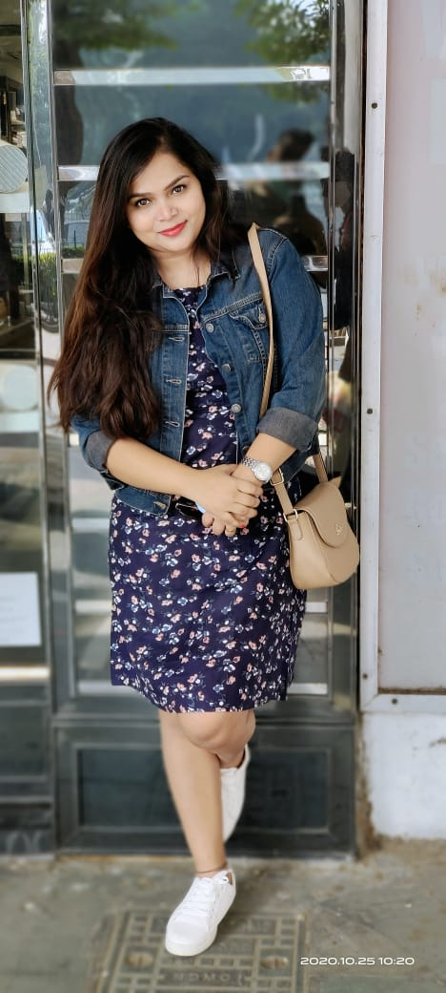
I am Sweta chaurasiya
Family and relatives calls me – Sonu , soni
Born – 15/12/1991
Father Name – Nagendra prasad
Mother name – Gayatri devi

Slide 3



Qualification and experience

Slide 4
Experience

